Slide 1

SENTIMENT ANALYSIS
OF MOVIE REVIEWS WITH
MACHINE LEARNING & DEEP LEARNING
MODELS
ANGUS ONG CHRISTINE ERIC LI QIN FAN PEIQIONG ZHU YUDI
G2304661L G2304472B G2405157F G2302391D G2304581E
KM6312 Data Mining and Analysis
23 Nov 2024

Slide 2
01
Introduction
02
Background
Agenda Overview
03
Methodology
04
EDA
05
Results
06
Conclusion

Slide 3


INTRODUCTION

Slide 4
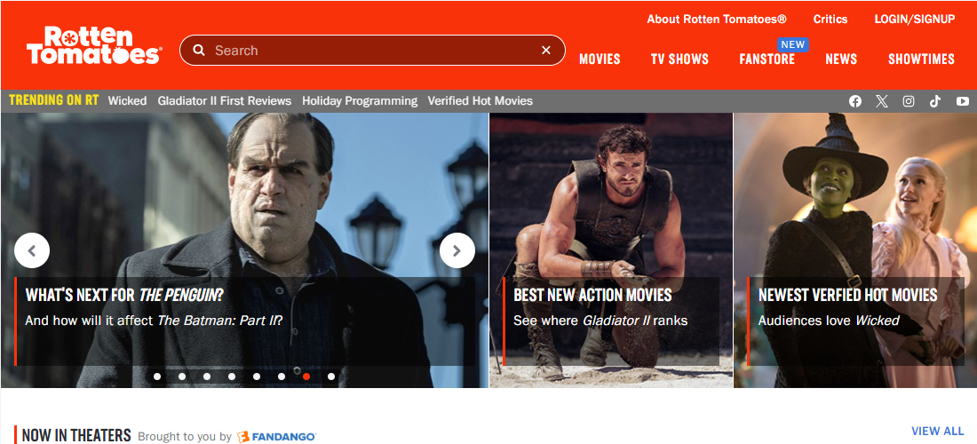


INTRODUCTION

Slide 5
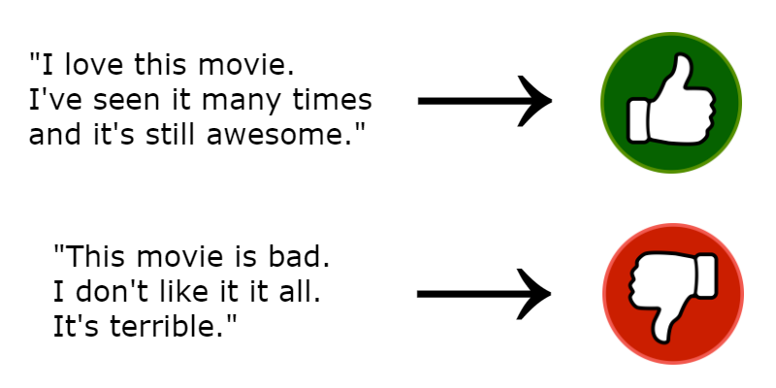
BACKGROUND
Sentiment Analysis / Opinion Mining: field of study that analyzes the attitudes, emotions and viewpoints of people communicated through texts
Sentiment Classification: Positive or Negative

Slide 6
BACKGROUND
Why Sentiment Analysis?
increased use of machine learning techniques in Natural Language Processing
broad availability of datasets for training models
relative ease of web scraping
Common machine learning methods | Common machine learning methods
Machine learning | Deep learning
Regression Support Vector Machines (SVM) Decision Tree Random Forests K-nearest Neighbors | Neural Networks Large Language Models (LLM) e.g., BERT (Bidirectional Encoder Representations from Transformers)

Slide 7
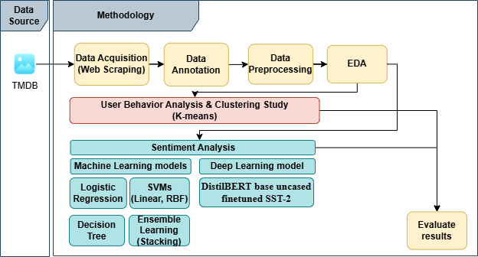
METHODOLOGY

Slide 8
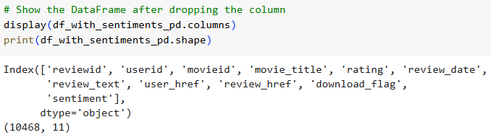
METHODOLOGY
Data Acquisition
Data Annotation
Data Preprocessing
Web scraping of box office movies for diverse reviews from The Movie Database (TMDB)
5,000 movies and 10,468 reviews
Tools: Selenium, ChromeDriver, Beautiful Soup
Use pre-trained models (distilbert-base-uncased-finetuned-sst-2-english) to label data with ‘positive’ & ‘negative’ labels.
Case folding
Remove URLs, special characters, digits, non ASCII, punctuations
Lemmatization

Slide 9
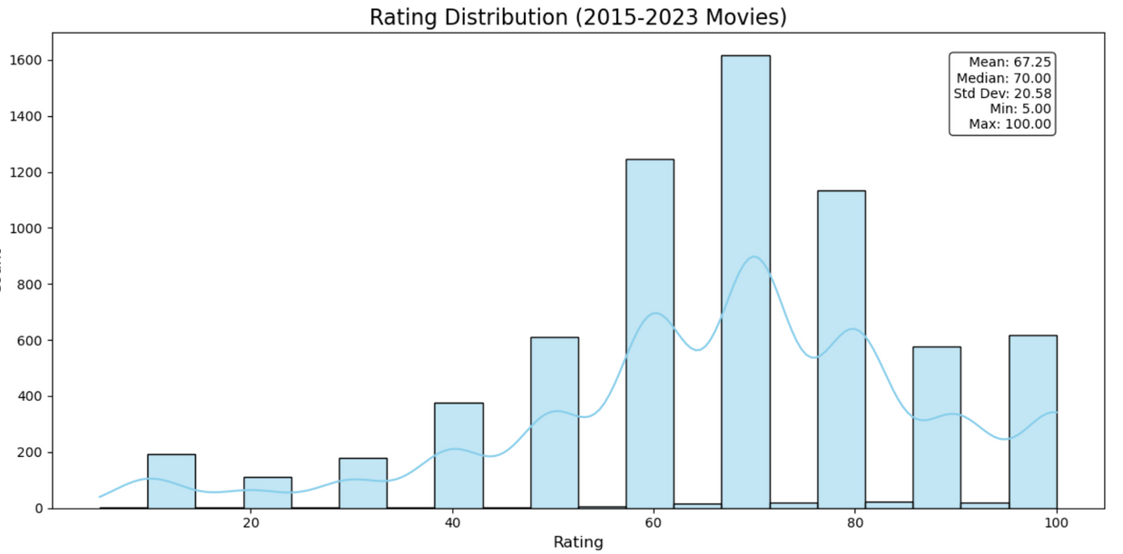
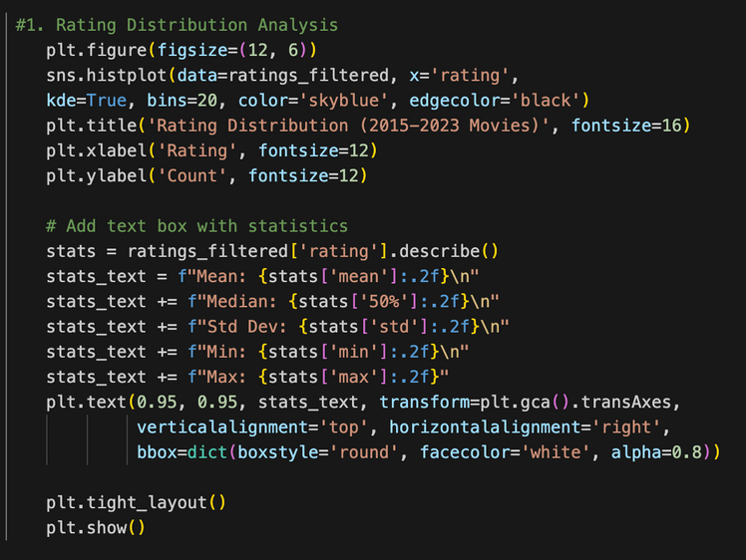
EXPLORATORY DATA ANALYSIS
Rating Distribution Analysis
Mean: 67.25 | Median: 70.00 | Std Dev: 20.58
Left-skewed distribution： users tend to give moderately positive ratings.
The distribution exhibited distinct peaks at integer values (particularly at multiples of 10), indicating users' preference for round numbers when expressing their opinions.

Slide 10
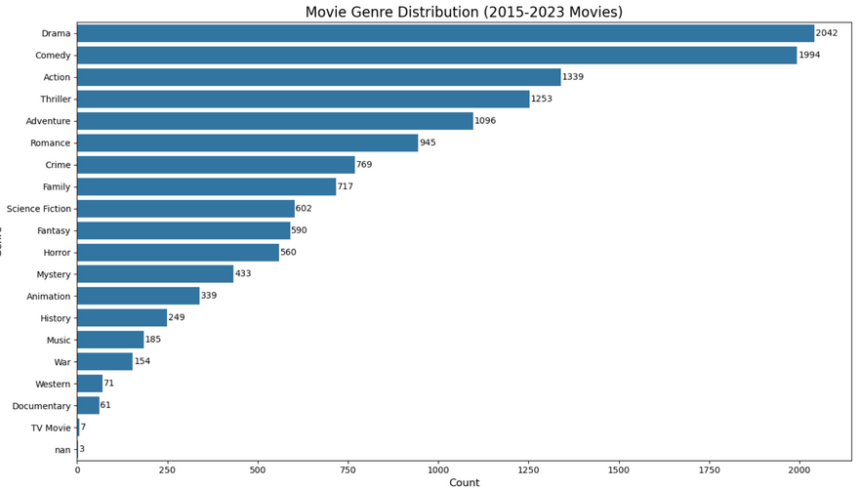
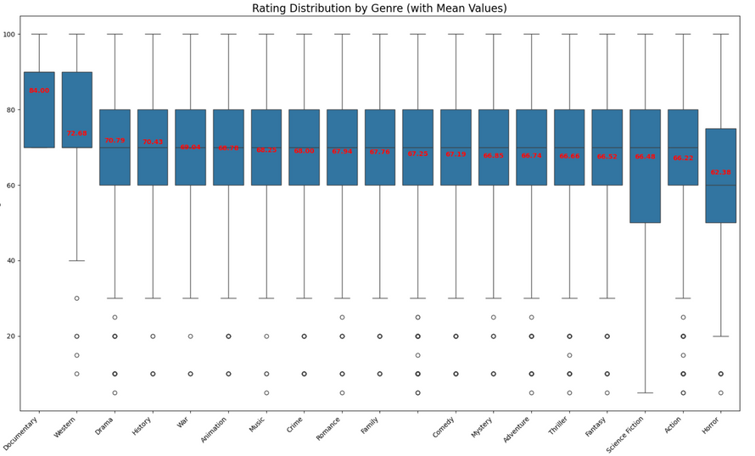
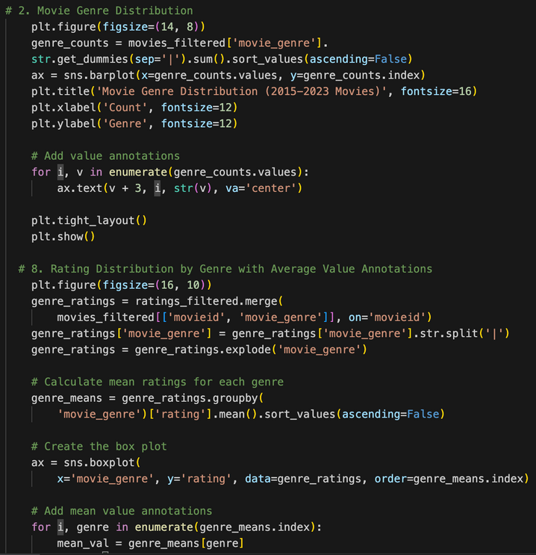
EXPLORATORY DATA ANALYSIS
Genre Analysis
Most Common Genres:
Drama: 2,042 films
Comedy: 1,994 films
Action: 1,339 films
Thriller: 1,253 films
Highest:
Documentary (84.36)
Western (81.88)
Rating by Genre:
Lowest:
Horror (61.45)
Action (66.32)
Genre-specific patterns reveal significant impact on user sentiment, where mainstream genres exhibit moderate ratings while niche genres show more polarized rating distributions, highlighting the importance of genre context in sentiment prediction

Slide 11
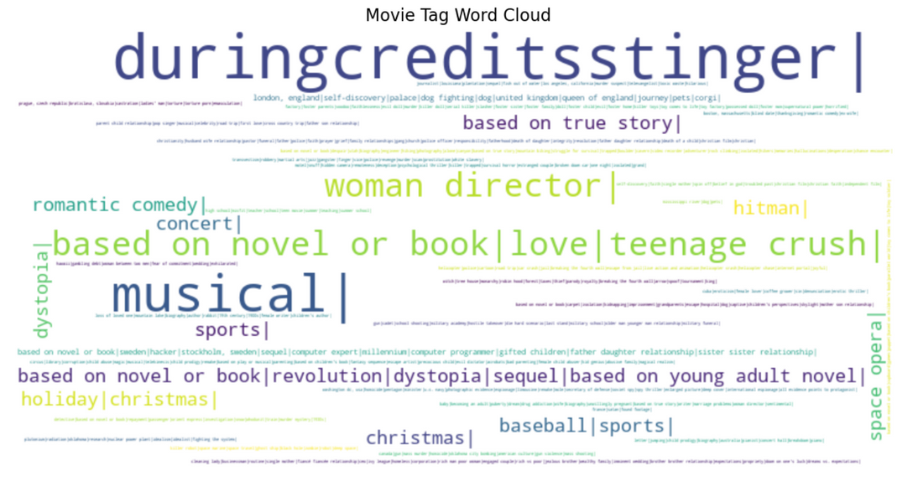
EXPLORATORY DATA ANALYSIS
Tag Analysis
Total tags: 5,000 | Unique tags: 4,913
Most Popular Tags: "duringcreditsstinger" (0.12%),"musical" (0.08%)
User-generated tags provide contextual features that capture specific movie attributes and viewer preferences, serving as valuable input for enhancing sentiment analysis models

Slide 12
EXPLORATORY DATA ANALYSIS
Why EDA Matters for Sentiment Analysis？
EDA findings reveal that review sentiment is influenced by:
Rating patterns → Need to account for inherent biases in scores
Genre context → Different benchmarks for different genres
User tags → Additional features beyond numerical ratings
This complex interaction of factors informs a more nuanced approach to sentiment modeling

Slide 13
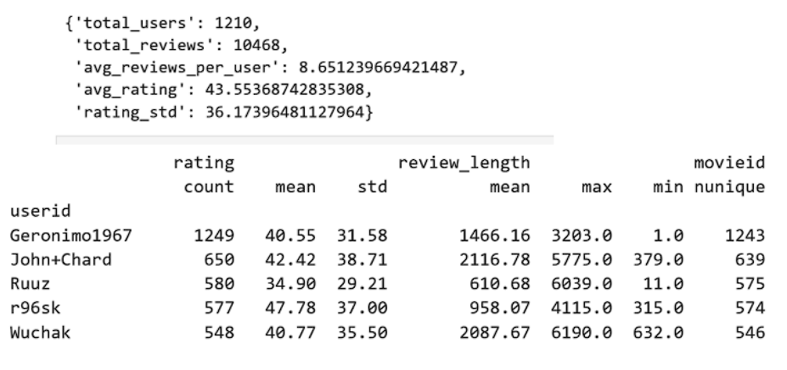
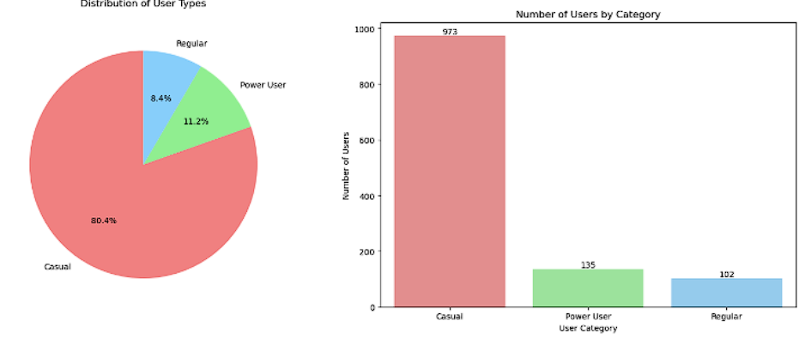
USER BEHAVIOUR ANALYSIS
User statistic and engagement metrics
F
Top 5 users have contributed more than 30% of the total reviews
TMDB Users: casual, regular, power

Slide 14
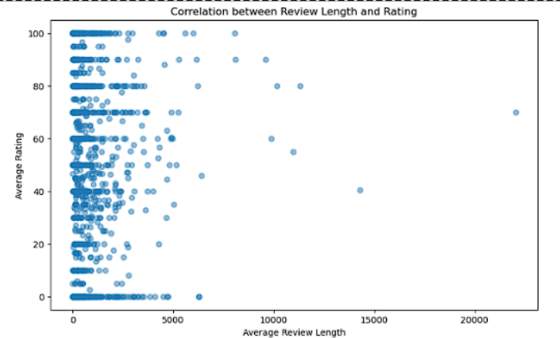
USER BEHAVIOUR ANALYSIS
2. Correlation between review length and rating
The coefficient is 0.022, no significant linear relationship between how long users give reviews and how much rating
Other factors:
personal writing style
time availability
user engagement level

Slide 15
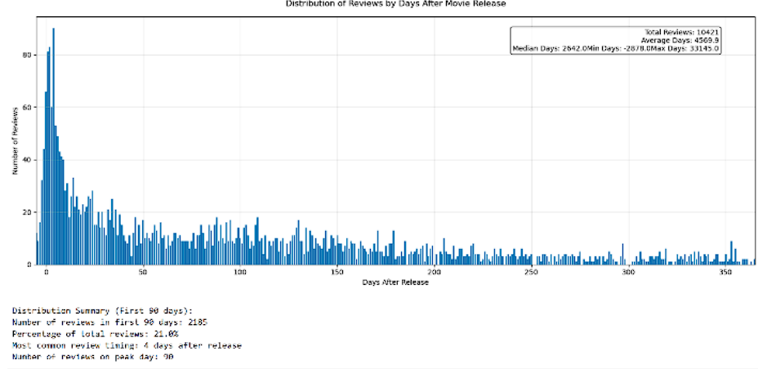
USER BEHAVIOUR ANALYSIS
3. Review timing after movie release
2,185 reviews amounting to 21% of total 10,468 reviews are given within 90 days (3 months) after movie release date
The most common review date is 4 days after movie release date

Slide 16
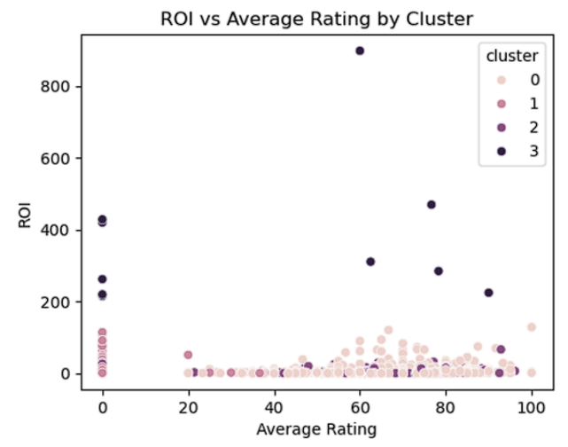
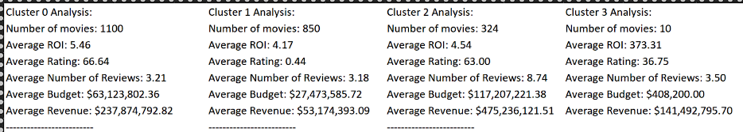
CLUSTERING
Return on Investment (ROI) x rating
Cluster 0 is mainstream successes movies
cluster 2 including 324 movies was identified as blockbusters group
Cluster 3 was a surprise group and most likely pertaining to indie films
Cluster 1 including 850 movies was identified as underperformance group

Slide 17
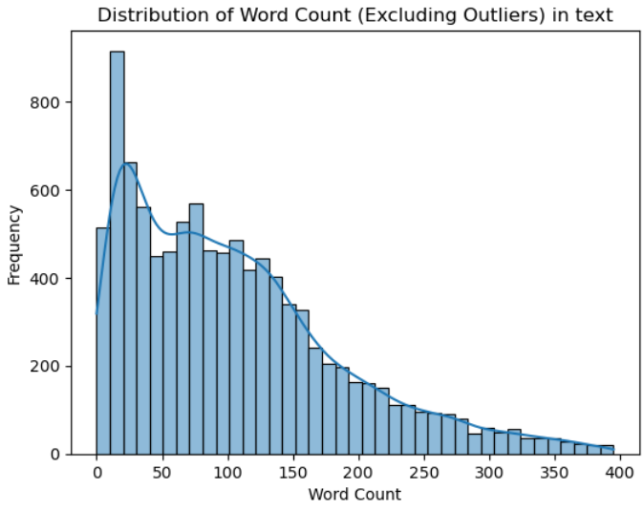
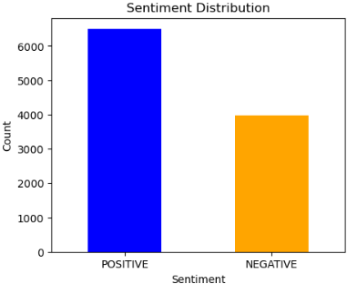
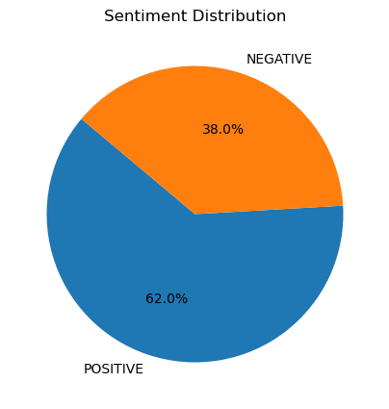
DATA DISTRIBUTION
Due to imbalanced dataset, class weight ‘balanced’ must be applied
For BERT model, max length is set to 256

Slide 18
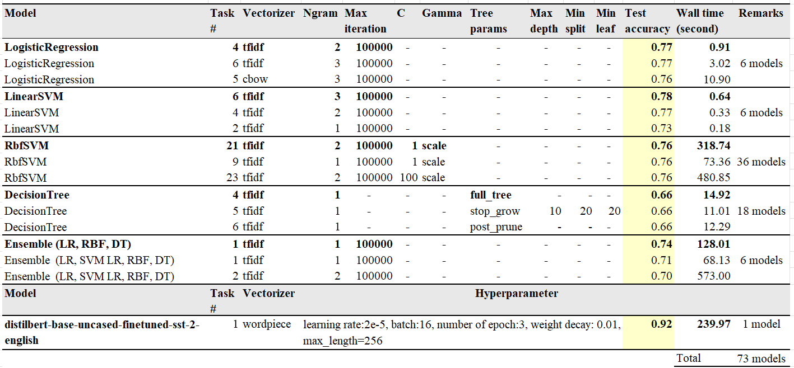
SENTIMENT ANALYSIS MODELS & RESULTS
Notes:
Our study is to determine best model for sentiment analysis task using techniques we learned in this class and beyond. So, we experimented with more than 70 models and their hyperparameters. This table shows the top 3 from each.
Based on our experiments, we conclude logistic regression and support vector machine models generally performs quite well >0.75 However, note that RBF SVM training is 200 times slower.
The decision tree produces the lowest accuracy. This indicates that although decision tree can be used for classification task, it is not the best model for NLP task especially high dimensional data and sparse features like movie reviews.
The ensemble model also performs slightly poorer that the individual base classifier.

Slide 19
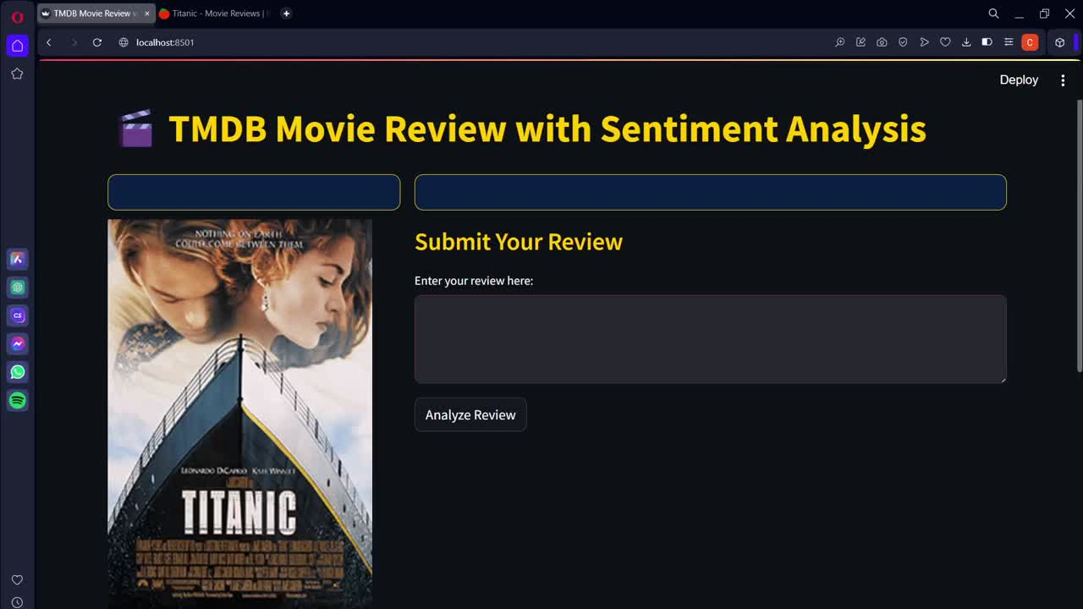
INFERENCE

Slide 20
KEY FINDINGS
TF-IDF VS BOW
ENSEMBLE MODEL IS NOT ALWAYS BETTER
MACHINE LEARNING
VS DEEP LEARNING
TF-IDF vectorization results in higher test accuracy for all machine learning models.
Incompatible base models
Diminishing returns
DL model offers superior performance for sentiment analysis tasks.
Transfer learning capability (DL) vs Train from scratch (ML)

Slide 21
CONCLUSION
Model | Test Accuracy | Remarks
Linear SVM | 0.78 | Best-performing machine learning model.
Logistic Regression | 0.77 | Second-best machine learning model.
RBF SVM | 0.76 | Handles non-linear data well but underperformed.
Decision Tree | 0.63-0.66 | Poor performance, unsuitable for the dataset.
Ensemble Learning | 0.74 | Did not improve over individual models.
DistilBERT | 0.92 | Best overall performance, excels at contextual sentiment analysis.

Slide 22
CONCLUSION
Dataset size and diversity are limited, with imbalanced sentiment distribution
Machine learning models rely on basic feature extraction, affecting performance
Deep learning models require high computational resources
Analysis is restricted to English-only reviews, limiting broader applicability.
Expand and diversify the dataset with balanced samples and richer metadata
Optimize feature engineering and ensemble techniques for machine learning models
Extend analysis to multiple languages and adapt models for multilingual data
LIMITATIONS
FUTURE DIRECTIONS

Slide 23
THANK YOU!
ANGUS ONG CHRISTINE ERIC LI QIN FAN PEIQIONG ZHU YUDI

